Slide 1
Ch 2: Assembly Language Programming

Slide 2
8085 microprocessor 2.3(in detail functional architecture and pin diagram)
The Intel 8085 A is a complete 8 bit parallel central processing unit.
It is an 8-bit microprocessor i.e. it can accept, process, or provide 8-bit data simultaneously.
It operates on a single +5V power supply connected at V_{cc}; power supply ground is connected to V_{ss}.
It operates on clock cycle with 50% duty cycle.
It has on chip clock generator. This internal clock generator requires tuned circuit like LC, RC or crystal. The internal clock generator divides oscillator frequency by 2 and generates clock signal, which can be used for synchronizing external devices.
It can operate with a 3 MHz clock frequency. The 8085A-2 version can operate at the maximum frequency of 5 MHz.

Slide 3
It has 16 address lines, hence it can access (2¹⁶) 64 Kbytes of memory.
It provides 8 bit I/O addresses to access (2⁸ ) 256 I/O ports.
In 8085, the lower 8-bit address bus (A₀ – A₇) and data bus (D₀ – D₇) are Multiplexed to reduce number of external pins. But due to this, external hardware (latch) is required to separate address lines and data lines.
It supports 74 instructions with the following addressing modes :
Immediate Register Direct Indirect Implied

Slide 4
The Arithmetic Logic Unit (ALU) of 8085 performs :
8 bit binary addition with or without carry 16 bit binary addition
2 digit BCD addition.
8-bit binary subtraction with or without borrow
8-bit logical AND, OR, EX-OR, complement (NOT), and bit shift operations.
It has 8-bit accumulator, flag register, instruction register, six 8-bit general purpose registers (B, C, D, E, H and L) and two 16-bit registers. (SP and PC).
Getting the operand from the general purpose registers is more faster than from memory.
Hence skilled programmers always prefer general purpose registers to store program variables than memory.

Slide 5
It provides five hardware interrupts : TRAP, RST 7.5, RST 6.5, RST 5.5 and INTR.
It has serial I/O control which allows serial communication.
It provides control signals (IO/M, RD, WR) to control the bus cycles, and hence external bus controller is not required.
The external hardware (another microprocessor or equivalent master) can detect which machine cycle microprocessor is executing using status signals (IO/M, S₀, S₁). This Features of 8085 Microprocessor is very useful when more than one processors are using common system resources (memory and I/O devices).
It has a mechanism by which it is possible to increase its interrupt handling capacity.
The 8085 has an ability to share system bus with Direct Memory Access controller. This Features of 8085 Microprocessor allows to transfer large amount of data from I/O device to memory or from memory to I/O device with high speeds.

Slide 6
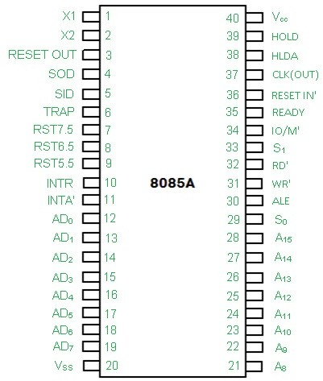
Pin diagram and signals of 8085 microprocessor

Slide 7
1. Address Bus and Data Bus:
The address bus is a group of sixteen lines
i.e. A0-A15.
The address bus is unidirectional,
i.e., bits flow in one direction from the microprocessor unit to the peripheral devices and uses the high order address bus.

Slide 8
2. Control and Status Signals:
ALE – It is an Address Latch Enable signal. It goes high during first T state of a machine cycle and
enables the lower 8-bits of the address, if its value is 1 otherwise data bus is activated.
IO/M’ – It is a status signal which determines whether the address is for input-output or memory.
When it is high(1) the address on the address bus is for input-output devices. When it is low(0) the
address on the address bus is for the memory.
SO, S1 – These are status signals.
They distinguish the various types of operations such as halt, reading, instruction fetching or writing.
RD’ – It is a signal to control READ operation. When it is low the selected memory or input-output device is read.
WR’ – It is a signal to control WRITE operation. When it goes low the data on the data bus is
written into the selected memory or I/O location.
READY – It senses whether a peripheral is ready to transfer data or not. If READY is high(1) the
peripheral is ready. If it is low(0) the microprocessor waits till it goes high. It is useful for interfacing low speed devices.

Slide 9
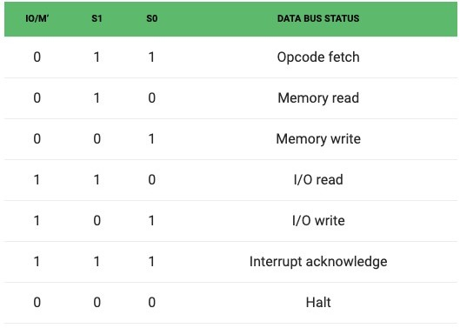

Slide 10
3. Power Supply and Clock Frequency:
Vcc – +5v power supply
Vss – Ground Reference
XI, X2 – A crystal is connected at these two pins. The frequency is internally divided by two, therefore, to operate a system at 3MHZ the crystal should have frequency of 6MHZ.
CLK (OUT) – This signal can be used as the system clock for other devices.

Slide 11
4. Interrupts and Peripheral Initiated Signals:
The 8085 has five interrupt signals that can be used to interrupt a program execution.
INTR
RST 7.5
RST 6.5
(iv) RST 5.5
(v) TRAP
The microprocessor acknowledges Interrupt Request by INTA’ signal. In
addition to Interrupts, there are three externally initiated signals namely
RESET, HOLD and READY. To respond to HOLD request, it has one signal called HLDA.
INTR – It is an interrupt request signal.
INTA’ – It is an interrupt acknowledgment sent by the microprocessor after INTR is received.

Slide 12
5. Reset Signals:
RESET IN’ – When the signal on this pin is low(0), the program- counter is set to zero, the buses are tristated and the microprocessor unit is reset.
RESET OUT – This signal indicates that the MPU is being reset. The signal can be used to reset other devices.

Slide 13
6. DMA Signals:
HOLD – It indicates that another device is requesting the use of the address and data bus.
Having received HOLD request the microprocessor relinquishes the use of the buses as soon as the current machine cycle is completed.
Internal processing may continue. After the removal of the HOLD signal the processor regains the bus.
HLDA – It is a signal which indicates that the hold request has been received after the removal of a HOLD request, the HLDA goes low.

Slide 14
7. Serial I/O Ports:
Serial transmission in 8085 is implemented by the two signals,
SID and SOD – SID is a data line for serial input where as SOD is a data line for serial output.

Slide 15
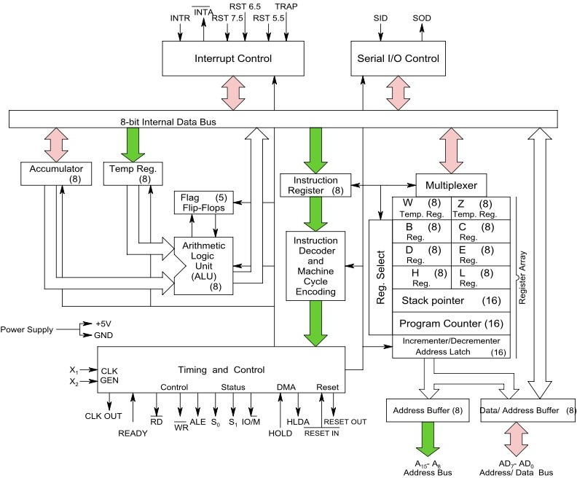
Internal Architecture of 8 bit microprocessor

Slide 16
Arithmetic and Logical Unit
The arithmetic logic unit performs the computing functions,
it includes the accumulator, the temporary register, the arithmetic and logic circuits and five flags.
The temporary register is used to hold data during an arithmetic/logic operation.
The result is stored in the accumulator; the flags (flip-flops) are set or reset according to the result of the operation.

Slide 17
Accumulator (register A)
It is an 8 bit register that is the part of ALU.
This register is used to store the 8-bit data and to perform arithmetic and logic operations and 8085 microprocessor is called accumulator based microprocessor.
When data is read from input port, it first moved to accumulator and when data is sent to output port, it must be first placed in accumulator.

Slide 18
Temporary registers(W & Z): They are 8 bit registers not accessible to the programmer.
During program execution, 8085A places the data into it for a brief period.
Instruction register(IR): It is a 8 bit register not accessible to the programmer.
It receives the operation codes of instruction from internal data bus and passes to the instruction decoder which decodes so that microprocessor knows which type of operation is to be performed.
Register Array: (Scratch pad registers B, C, D, E): It is a 8 bit register accessible to the programmers.
Data can be stored upon it during program execution. These can be used individually as 8-bit registers or in pair BC, DE as 16 bit registers.
The data can be directly added or transferred from one to another.
Their contents may be incremented or decremented and combined logically with the content of the accumulator.

Slide 19
Register H & L: - They are 8 bit registers that can be used in same manner as scratch pad registers.
Stack Pointer (SP): - It is a 16 bit register used as a memory pointer. It points to a memory location in R/W memory, called the stack.
The beginning of the stack is defined by loading a 16- bit address in the stack pointer.
Program Counter (PC): - Microprocessor uses the PC register to sequence the execution of the instructions.
The function of PC is to point to the memory address from which the next byte is to be fetched.
When a byte is being fetched, the PC is incremented by one to point to the next memory location.

Slide 20

Flags
Register consists of five flip flops, each holding the status of different states separately is known as flag register and each flip flop are called flags.
8085A can set or reset one or more of the flags and are sign(S), Zero (Z), Auxiliary Carry (AC) and Parity (P) and Carry (CY).
The state of flags indicates the result of arithmetic and logical operations, which in turn can be used for decision making processes.

Slide 21
Carry: - If the last operation generates a carry its status will 1 otherwise 0. It can handle the carry or borrow from one word to another.
Zero: - If the result of last operation is zero, its status will be 1 otherwise o. It is often used in loop control and in searching for particular data value.
Sign: - If the most significant bit (MSB) of the result of the last operation is 1 (negative), then its status will be 1 otherwise 0.
Parity: - If the result of the last operation has even number of ones
,even parity), its status will be 1 otherwise 0.
Auxiliary carry: - If the last operation generates a carry from the lower half word (lower nibble), its status will be 1 otherwise 0. Used for performing BCD arithmetic.

Slide 22
Example 1
MVI A 30 (load 30H in register A) MVI B 40 (load 40H in register B).
00110000
- 01000000
SUB B (A = A – B) = 11000000. with borrow 1 These set of instructions will set the sign flag to 1 as 30 – 40 is a negative number.
Example
MVI A 40 (load 40H in register A) MVI B 30 (load 30H in register B) SUB B (A = A – B)
These set of instructions will reset the sign flag to 0 as 40 – 30 is a positive number.

Slide 23
Example 3
MVI A 10 (load 10H in register A) SUB A (A = A – A)
These set of instructions will set the zero flag to 1 as 10H – 10H is 00H
Example 4
MOV A 2B (load 2BH in register A) MOV B 39 (load 39H in register B) ADD B (A = A + B)
These set of instructions will set the auxiliary carry flag to 1, as on adding 2B and 39, addition of lower order nibbles B and 9 will generate a carry.

Slide 24
Example 5
MVI A 05 (load 05H in register A)
This instruction will set the parity flag to 1 as the BCD code of 05H is 00000101, which contains even number of ones i.e. 2.
Example 6
MVI A 30 (load 30H in register A) MVI B 40 (load 40H in register B) SUB B (A = A – B)
These set of instructions will set the carry flag to 1 as 30 – 40 generates a carry/borrow.
Example 7
MVI A 40 (load 40H in register A) MVI B 30 (load 30H in register B) SUB B (A = A – B)
These set of instructions will reset the sign flag to 0 as 40 – 30 does not generate any carry/borrow.

Slide 25
Timing and Control Unit:
This unit synchronizes all the microprocessor operations with the clock
And generates the control signals necessary for communication between the microprocessor and peripherals.
The control signals are similar to the sync pulse in an oscilloscope.
The RD’ and WR’ are sync pulses indicating the availability of data on data bus.

Slide 26
Interrupt controls:
The various interrupt controls signals (INTR, RST 5.5, RST 6.5, RST 7.5 and TRAP) are used to interrupt a microprocessor.
Serial I/O controls: Two serial I/O control signals (SID and SOD) are used to implement the serial data transmission.

Slide 27
Instructions in 8085 microprocessor
The computer can be used to perform a specific task, only by specifying the necessary steps to complete the task
The collection of such ordered steps forms a program of a computer These ordered steps are the instructions .
So, Instruction are the command given to the processor to perform the specified task.
Computer instructions are stored in central memory locations and are executed sequentially one at a time.
The control reads an instruction from a specific address in memory and executes it.
It then continues by reading the next instruction in sequence and executes it until the completion of the program.

Slide 28
Instruction cycle
Instruction contains in the program and is pointed by the program counter.
It is first moved to the instruction register and is decoded in binary form and stored as an instruction in the memory.
The computer takes a certain period to complete this task i.e., instruction fetching, decoding and executing on the basis of clock speed.
Such a time period is called Instruction cycle and consists three cycles namely fetch and decode and Execute cycle

Slide 29
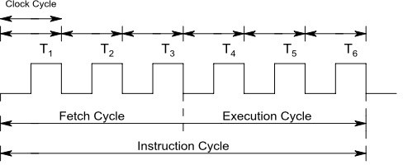
In the fetch cycle the central processing unit obtains the instruction code the memory for its execution.
Once the instruction code is fetched from memory, it is then executed.
The execution cycle consists the calculating the address of the operands, fetching them, performing operations on them and finally outputting the result to a specified location.

Slide 30
2.1 Instruction formats
An instruction manipulates the data and a sequence of instructions constitutes a program.
Generally each instruction has two parts: one is the task to be performed, called the operation code (Op-Code) field, and the second is the data to be operated on, called the operand or address field.
The operand (or data) can be specified in various ways. It may include 8-bit (or 16-bit) data, an internal register, a memory location, or an 8- bit (or 16-bit) address.
The Op-Code field specifies how data is to be manipulated and address field indicates the address of a data item.

Slide 31
For example:
ADD R1, R0 Op-code address
Here R0 is the source register and R1 is the destination register. The instruction adds the contents of R0 with the content of R1 and stores result in R1.
8085 can handle at the maximum of 256 instructions (2 pow 8)(246 instructions are used, rest are hidden) . The sheet which contains all these instructions with their hex code, mnemonics, descriptions and function is called an instruction sheet.
Depending on the number of address specified in instruction sheet, the instruction format can be classified into the categories.

Slide 32
Instruction format in 8085
One address format (1 byte instruction): Here 1 byte will be Op-code and operand will be default. E.g. ADD B, MOV A,B
Two address format (2 byte instruction) :Here first byte will be Op- code and second byte will be the operand/data.
E.g. IN 40H, MVI A, 8-bit Data
Three address format (3 byte instruction): Here first byte will be Op- code, second and third byte will be operands/data. That is 2nd byte- lower order data.
3rd byte higher order data E.g. LXI B, 4050 H
Micro operation specifies the transfer of data into or out of a register.

Slide 33
2.4 Addressing modes
Instructions are command to perform a certain task in microprocessor.
The instruction consists of op-code and data called operand. The operand may be the source only, destination only or both of them.
In these instructions, the source can be a register, a memory or an input port. Similarly, destination can be a register, a memory location, or an output port.
The various format (way) of specifying the operands are called addressing mode. So addressing mode specifies where the operands are located rather than their nature.
The 8085 has 5 addressing modes:

Slide 34
Direct addressing mode:
The instruction using this mode specifies the effective address as part of instruction.
The instruction size either 2-bytes or 3-bytes with first byte op-code followed by 1 or 2 bytes of address of data.
LDA 9500H
IN80H
Register Direct addressing mode:
This mode specifies the register or register pair that contains the data.
MOV A, B, Here register B contains data rather than address of the data.
Other examples are: ADD, XCHG etc.

Slide 35
Register Indirect addressing mode:
In this mode the address part of the instruction specifies the memory whose contents are the address of the operand.
So in this type of addressing mode, it is the address of the address rather than address itself. (One operand is register)
MOV R, M MOV M, R STAX, LDAX etc.
Immediate addressing mode:
In this mode, the operand position is the immediate data.
For 8-bit data, instruction size is 2 bytes and for 16 bit data, instruction size is 3 bytes. MVI A, 32H
LXI B, 4567H
Implied or Inherent addressing mode:
The instructions of this mode do not have operands. E.g. NOP: No operation HLT: Halt
EI: Enable interrupt
DI: Disable interrupt

Slide 36
2.2 Instruction Set/ Group in 8085 microprocessor 2.5 Data transfer instructions, Arithmetic and Logical instructions, Program control instructions
An instruction is a binary pattern designed inside a microprocessor to perform a specific function (task).
The entire group of instructions(74 types, 256 instructions) called the instruction set. The 8085
instruction set can be classified in to 5- different groups.
Data transfer group: The instructions which are used to transfer data from one register to
another register or register to memory.
Arithmetic group: The instructions which perform arithmetic operations such as addition, subtraction, increment, decrement etc.
Logical group: The instructions which perform logical operations such as AND, OR, XOR, COMPARE etc.
Branching group: The instructions which are used for looping and branching are called branching instructions like jump, call etc.
Miscellaneous group: The instructions relating to stack operation, controlling purposes such as interrupt operations are fall under miscellaneous group including machine control like HLT, NOP.

Slide 37
Data transfer group instructions:
It is the longest group of instructions in 8085.
This group of instruction copy data from a source location to destination location without modifying the contents of the source.
The transfer of data may be between the registers or between register and memory or between an I/O device and accumulator.
None of these instructions changes the flag.

Slide 38
1) MOV Rd, Rs (move register instruction)
1 byte instruction
Copies data from source register to destination register.
Rd & Rs may be A, B, C, D, E, H &L
E.g. MOV A, B
MVI R, 8 bit data (move immediate instruction)
2 byte instruction
Loads the second byte ( 8 bit immediate data) into the register specified.
R may be A, B, C, D, E, H & L
E.g. MVI C, 53H
C←53H

Slide 39
3) MOV M, R (Move to memory from register)
Copy the contents of the specified register to memory. Here memory is the location specified by contents of the HL register pair.
E.g. MOV M, B
MOV R, M (move to register from memory)
Copy the contents of memory location specified by HL pair to specified register.
E. g. MOV B, M

Slide 40
Write a program to load memory locations 7090 H and 7080 H with data 40H and 50H and then swap these data.
Solution : MVI H, 70H MVI L, 90H MVI A, 40H MOV M, A MOV C, M MVI L, 80H MVI B, 50H MOV M, B MOV D, M MOV M, C MVI L, 90H MOV M, D HLT

Slide 41
5.) LXI RP, 2 bytes (load register pair)
3-byte instruction
Load immediate data to register pair
Also point to the specified address.
Register pair may be BC, DE, HL & SP(Stack pointer)
1st byte- Op-code
2nd byte lower order data
3rd byte- higher order data
E.g. L X I B, 4532H; B <- 45, C <- 32H
MVI M, data (load memory immediate)
2 byte instruction.
Loads the 8-bit data to the memory location whose address is specified by the contents of HL pair. E.g. MVI M , 35H. ; [HL] <- 35H

Slide 42
7) LDA 4035H (Load accumulator directly)
3-byte instruction
Loads the accumulator with the contents of memory location whose address is specified by 16 bit address.
A← [4035H]
LDAX RP (Load accumulator indirectly)
1 byte instruction.
Loads the contents of memory location pointed by the contents of register pair to accumulator.
E. g. LDAX B
LXI B, 9000H LDAX B
B= 90, C= 00 A= [9000]
[A] <-- [[BC]]

Slide 43
9) STA 16-bit address (store accumulator contents direct)
– 3-byte instruction.
– Stores the contents of accumulator to specified address
– E.g. STA FA00H
[FA00] ← [A]
10) STAX RP [RP]
<-- A
– Store s the contents of accumulator to memory location specified by the contents of register pair.
1 byte instruction

Slide 44
E.g. STAX B
LXI B, 9500H LXI D, 9501H MVI A, 32H STAX B
MVI A, 7AH STAXD
output [9500] = 32 [9501] = 7A
[DE] ←A

Slide 45
11) IN 8-bit address
2-byte instruction
Read data from the input port address specified in the second byte and loads data into the accumulator i. e. input port content to accumulator:
E. g. IN 40H A ← [40H]
OUT 8-bit address
2-byte instruction
Copies the contents of the accumulator to the output port address specified in
the 2nd byte. That means accumulator to output port:
E. g. OUT 40H [40] ← A

Slide 46
13) LHLD 16-bit address ( Load HL directly)
3-byte instruction.
Loads the contents of specified memory location to L register and contents of next higher location to H-register.
E.g: LHLD 4050H
Let us consider one example instruction LHLD 4050H .
This instruction will occupy 3-Bytes and so 3 memory locations. First Byte will contain opcode 2AH,
second Byte will contain the low order address Byte 50H
and last Byte will contain high order address Byte 40H.
Let us suppose, 4050H and 4051H memory locations are holding values AAH and BBH
respectively.
Also HL register pair is containing initial value like CCH and DDH. Now after execution of LHLD 4050H instruction,
the updated content of H and L register will become AAH and BBH.

Slide 47
14) SHLD 16-bit address (store HL directly)
Opposite to LHLD.
Stores the contents of L-register to specified memory location and contents of H- register to next higher memory location.
E .g. LXI H, 9500H
SHLD 8500H [8500]=00 [8501]=95
15) XCHG (Exchange)
Exchanges DE pair with HL pair.
E. g.
LXI H, 7500H LXI D, 9532H
XCHG
H= 75, L=00 ,D=95, E=32 H=95, L=32 D=75 E=00

Slide 48
Arithmetic group Instructions
The 8085 microprocessor performs various arithmetic operations such as addition, subtraction, increment and decrement.
They effect the flags. After the result of arithmetic operations, the contents of flags are changed.
These arithmetic operations have the following mnemonics.
ADD R/M
1 byte add instruction.
Adds the contents of register/memory to the contents of the accumulator and stores the result in accumulator.
E. g. Add B; A ← [A] + [B]

Slide 49
2) ADI 8 bit data
2 byte add immediate instruction.
Adds the 8 bit data with the contents of accumulator and stores result in accumulator .
E g. ADI 9BH ; A ← A+9BH
3) SUB R/M
1 byte subtract instruction.
Subtracts the contents of specified register / m with the contents of accumulator and stores the result in accumulator.
SUB D ; A← A-D

Slide 50
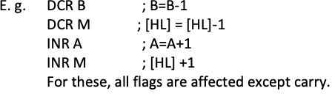
4) SUI 8 bit data
2 byte subtract immediate instruction.
Subtracts the 8 bit data from the contents of accumulator stores result in accumulator.
SUI D3H ; A ← A - D3H
5) INR R/M, DCR R/M
1 byte increment and decrement instructions.
Increase and decrease the contents of R(register) or M(memory) by 1 respectively.

Slide 51


6) INX Rp, DCX RP
Increase and decrease the register pair by 1.
Acts as 16 bit counter made from the contents of 2 registers (1 byte instruction)
No flags affected
7) ADC R/M and ACI 8-bit data ( addition with carry (1 byte))
ACI 8-bit data= immediate (2 byte).
Adds the contents of register or 8 bit data whatever used suitably with the previous carry.

Slide 52
8) SBB B/M
1 byte instruction.
Subtracts the contents of register or memory from the contents of accumulator and stores the result in accumulator.
SBB D
A<-- A-D-burrow
9) SBI 8 bit data
2 byte instruction.
Subtracts the 8-bit immediate data from the content of the accumulator and stores the result in accumulator.
SBI 70H ; A<-- A-70H-burrow

Slide 53

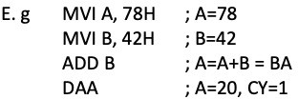
9) DAD Rp(double addition)
1 byte instruction.
Adds register pair with HL pair and store the 16 bit result in HL pair.
10) DAA (Decimal adjustment accumulator)
Used only after addition.
1 byte instruction.
The content of accumulator is changed from binary to two 4-bit BCD digits.

Slide 54
The arithmetic operation add and subtract are performed in relation to the contents of accumulator.
The features of these instructions are
They assume implicitly that the accumulator is one of the operands.
They modify all the flags according to the data conditions of the result.
They place the result in the accumulator.
They do not affect the contents of operand register or memory.
But the INR and DCR operations can be performed in any register or memory. These instructions
Affect the contents of specified register or memory.
Affect the flag except carry flag.

Slide 55
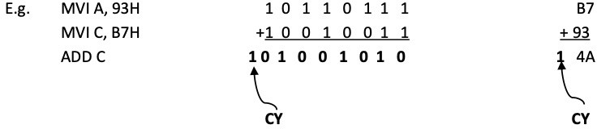
Addition operation in 8085:
8085 performs addition with 8-bit binary numbers and stores the result in accumulator.
If the sum is greater than 8-bits (FFH), it sets the carry flag.

Slide 56
Subtraction operation in 8085:
8085 performs subtraction operation by using 2’s complement and the steps used are:
1) Converts the subtrahend ,the number to be subtracted into its 1’ss complement
2) Adds 1 to 1’s complement to obtain 2’s complement of the subtrahend.
3) Adds 2’s complement to the minuend (the contents of the accumulator)
4) Complements the carry flag.

Slide 57
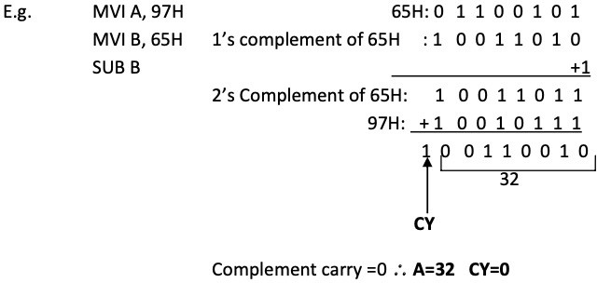

Slide 58
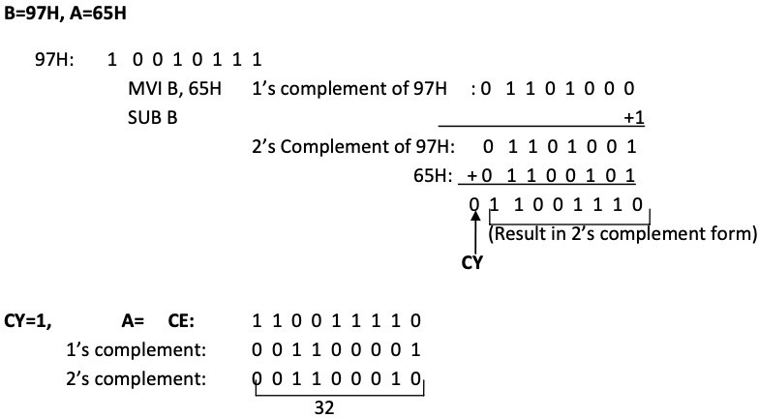
When cy = 0, then recomplement the result
1 1 0 0 1 1 1 0
0 0 1 1 0 0 0 1
+. 1
= 00110010
= 32H
=- 32 H ( placing negative sign infront of it)

Slide 59
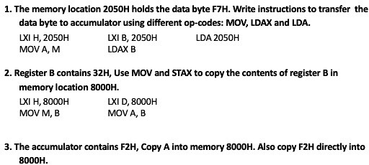

Slide 60
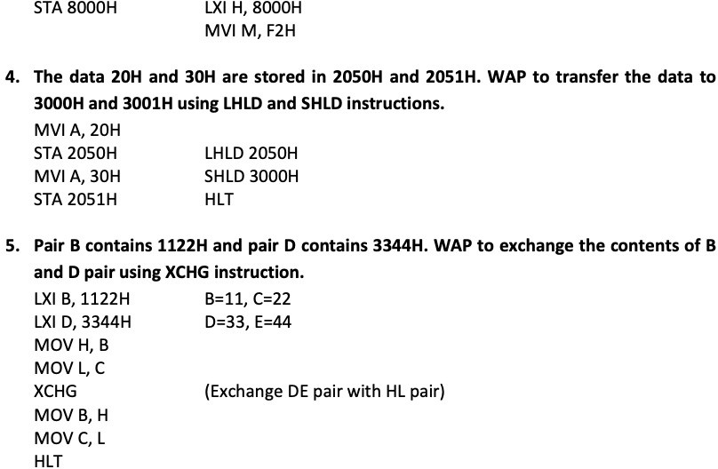

Slide 61
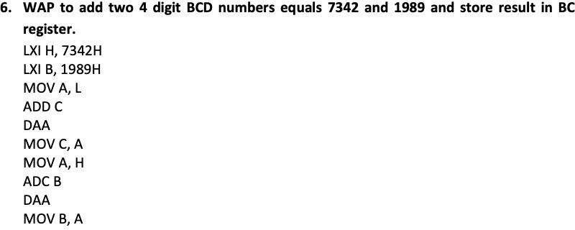

Slide 62
Addressing modes in 8085
Direct addressing mode:
The instruction using this mode specifies the effective address as part of instruction.
The instruction size either 2-bytes or 3-bytes with first byte op-code followed by 1 or 2 bytes of address of data.
LDA 9500H
IN80H
Register Direct addressing mode:
This mode specifies the register or register pair that contains the data.
MOV A, B, Here register B contains data rather than address of the data.
Other examples are: ADD, XCHG etc.

Slide 63
Register Indirect addressing mode:
In this mode the address part of the instruction specifies the memory whose contents are the address of the operand.
So in this type of addressing mode, it is the address of the address rather than address itself. (One operand is register)
MOV R, M MOV M, R STAX, LDAX etc.
Immediate addressing mode:
In this mode, the operand position is the immediate data.
For 8-bit data, instruction size is 2 bytes and for 16 bit data, instruction size is 3 bytes. MVI A, 32H
LXI B, 4567H
Implied or Inherent addressing mode:
The instructions of this mode do not have operands. E.g. NOP: No operation HLT: Halt
EI: Enable interrupt
DI: Disable interrupt

Slide 64
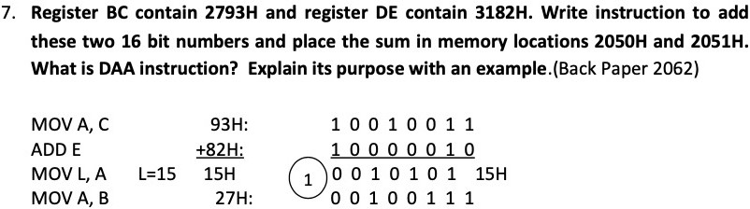
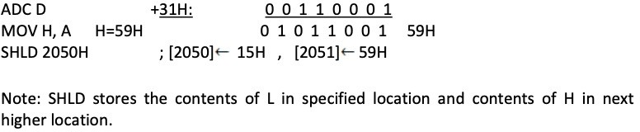

Slide 65
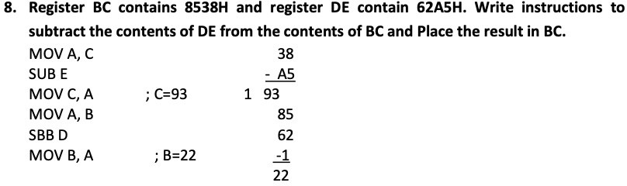

Slide 66
Logical Group Instructions:
A microprocessor is basically a programmable logic chip.
It can perform all the logic functions of the hardwired logic through its instruction set.
The 8085 instruction set includes such logic functions as AND, OR, XOR and NOT (Complement):
The following features hold true for all logic instructions:
The instructions implicitly assume that the accumulator is one of the operands.
All instructions reset (clear) carry flag except for complement where flag remain unchanged.
They modify Z, P & S flags according to the data conditions of the result.
Place the result in the accumulator.
They do not affect the contents of the operand register.

Slide 67
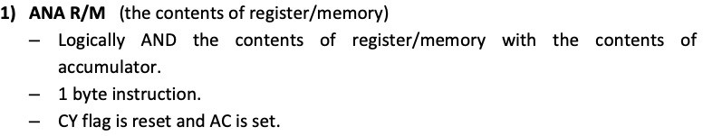
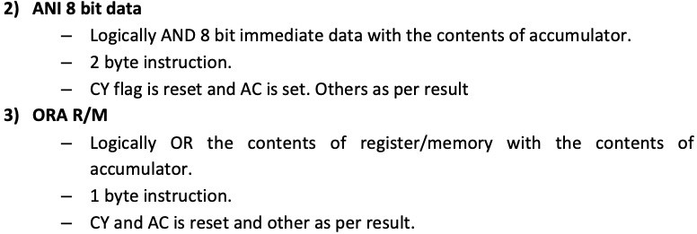

Slide 68
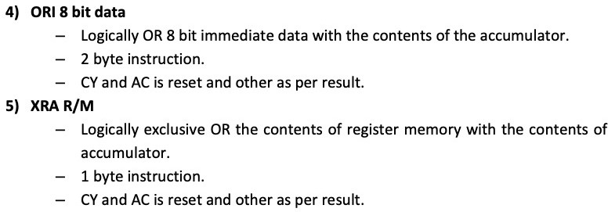
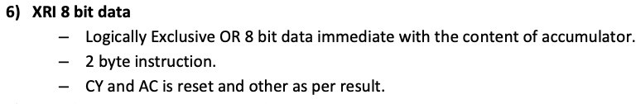

Slide 69
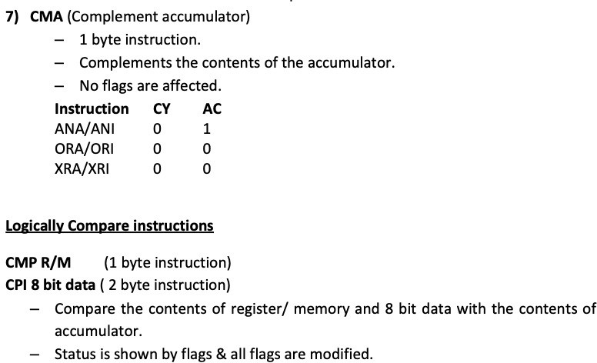
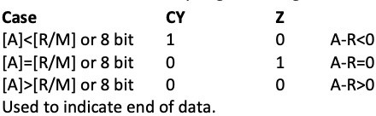

Slide 70
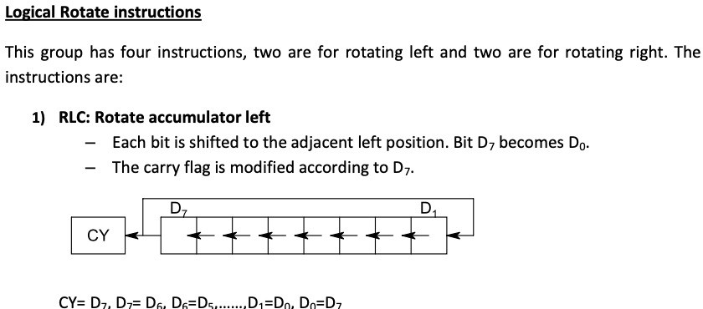

Slide 71
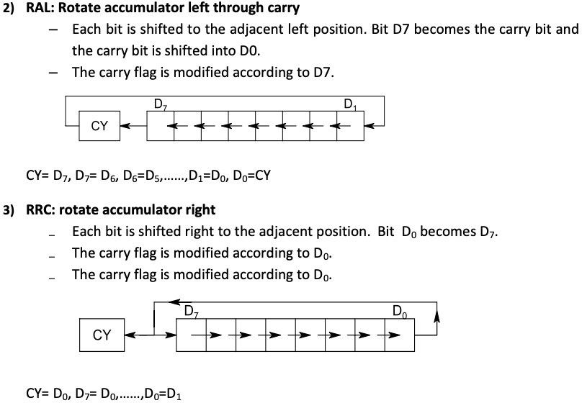

Slide 72
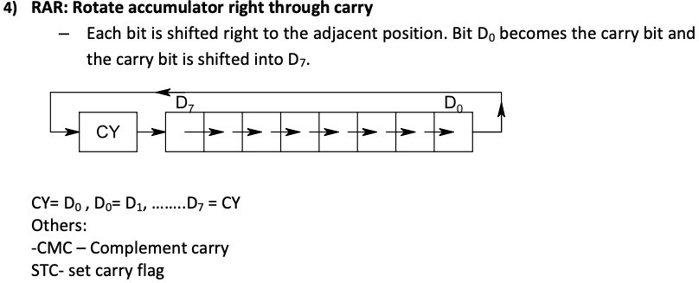

Slide 73
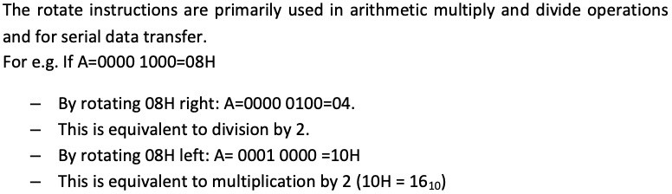
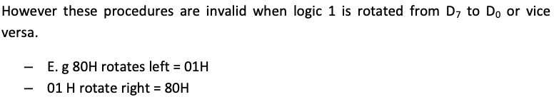

Slide 74
Branching Group Instructions:
The microprocessor is a sequential machine; it executes machine codes from one memory location to the next.
The branching instructions instruct the microprocessor to go to a different memory location and the microprocessor continues executing machine codes from that new location.
The branching instructions are the most powerful instructions because they allow the microprocessor to change the sequence of a program, either unconditionally or under certain test conditions.
The branching instruction code categorized in following three groups:

Slide 75
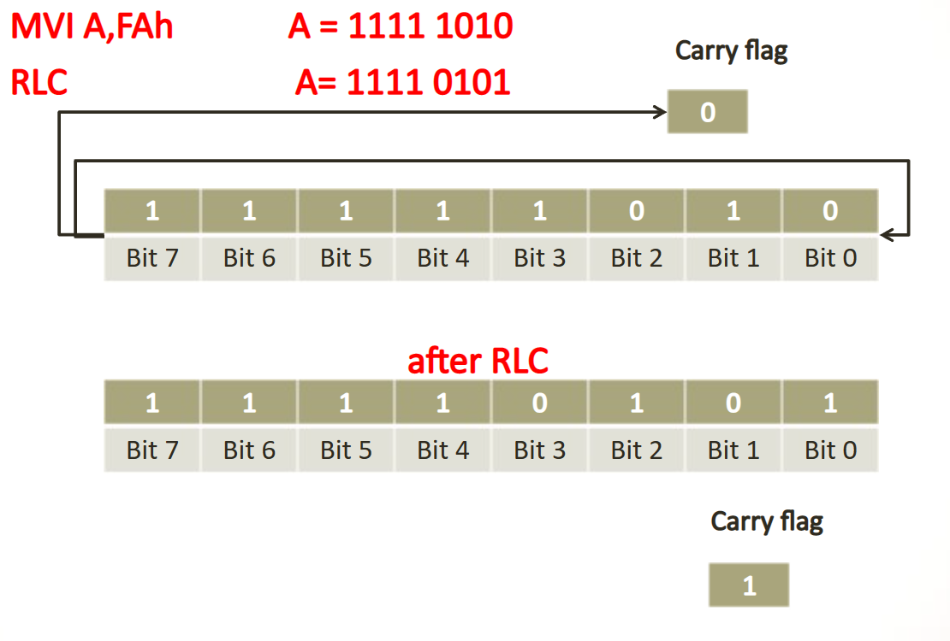

Slide 76
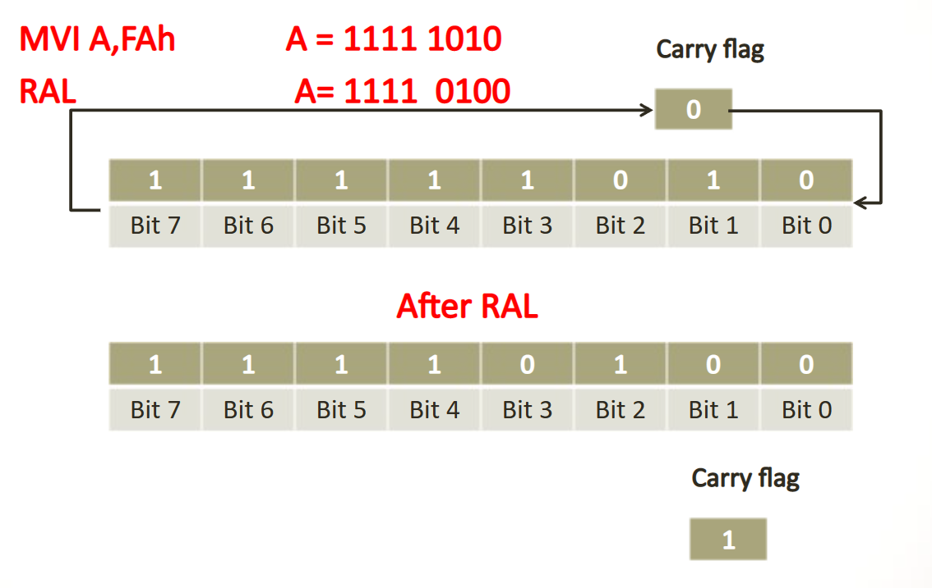

Slide 77
The branching instruction code categorized in following three groups:
Jump instructions
Call and return instruction
Restart instruction
Jump Instructions:
The jump instructions specify the memory location explicitly.
They are 3 byte instructions, one byte for the operation code followed by a 16 bit (2 byte) memory address.
Jump instructions can be categorized into unconditional and conditional jump.

Slide 78
Unconditional Jump
8085 includes unconditional jump instruction to enable the programmer to set up continuous loops without depending only type of conditions.
E.g. JMP 16 bit address: loads the program counter by 16 bit address and jumps to specified memory location.
JMP 4000H
Here, 40H is higher order address and 00H is lower order address. The lower order byte enters first and then higher order.
The jump location can also be specified using a label or name.

Slide 79
E.g.
Address. Label.
2000H.
2002H.
2004H.
Mnemonics.
MVI A, 80H
OUT 43H MVI A, 00H
L1: OUT 40H INR A
JMP L1 HLT
Hexcode
2006H.
2008H.
2009H.
200CH

Slide 80
Conditional Jump
The conditional jump instructions allow the microprocessor to make decisions based on certain conditions indicated by the flags.
After logic and arithmetic operations, flags are ser or reset to reflect the condition of data.
These instructions check the flag conditions and make decisions to change or not to change the sequence of program.
The four flags namely carry, zero, sign and parity used by the jump instruction.

Slide 81
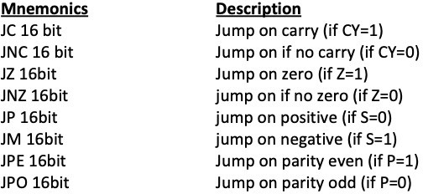

Slide 82
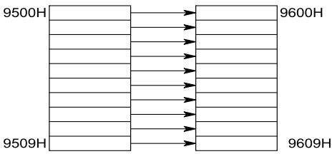
Write a program to transfer ten bytes of data from starting address 9500 H (table1) to 9600H (table 2)

Slide 83
Memory address | label | Mnemonics | Hexcode
C005 H |  | MVI B, 0AH
C006H |  |  | 0AH
C007H |  | LXI H, 9500H
C008H |  |  | 00H
C009H |  |  | 95H
C00AH |  | LXI D, 9600H
C00BH |  |  | 00H
C00CH |  |  | 96H
C00DH | UP : | MOVA,M
C00EH |  | STAX D
C00FH |  | INX H
C010H |  | INX D
C011H |  | DCR B
C012H |  | JNZ UP
C013H |  |  | 0DH
C014H |  |  | C0H
C015H |  | HLT | CFH

Slide 84
Write a program in C005 to transfer 30 data's from 8500H to A500H if data is odd else store 00H.
Memory | label | Mnemonics | Hexcode
C005 H |  | MVI B, 1EH
C006H |  |  | 1EH
C007H |  | LXI H, 8500H
C008H |  |  | 00H
C009H |  |  | 85H
C00AH |  | LXI D, A500H
C00BH |  |  | 00H
C00CH |  |  | A5H
C00DH | L2 : | MOVA,M
C00EH |  | ANI 01H
C00FH |  |  | 01H
C010H |  | JNZ L1
C011H |  |  | 18 H
C012H |  |  | C0 H
C013H |  | MVI A, 00H
C014H |  |  | 00H
C015H |  | JMP L3
C016H |  |  | 19 H
C017H |  |  | C0 H
C018H | L1 : | MOV A, M
C019H | L3 : | STAX D
C01AH |  | INX H
 |  | DCR B
 |  | JNZ L2
 |  |  | OD H
 |  |  | C0H
 |  | HLT | CF H
ANI. 01 H
for eg: A = 23 H = 00100011 (odd) ANDing with 00000001
= 00000001
If A = 22 H (even)
0010 0010
00000001
= 00000000

Slide 85
Call and return instructions: (Subroutine)
Call and return instructions are associated with subroutine technique. A subroutine is a group of instructions that perform a subtask.
A subroutine is written as a separate unit apart from the main program and
the microprocessor transfers the program execution sequence from main program to subroutine whenever it is called to perform a task.
After the completion of subroutine task microprocessor returns to main
program.
The subroutine technique eliminates the need to write a subtask repeatedly, thus it uses memory efficiently.
Before implementing the subroutine, the stack must be defined; the stack
is used to store the memory address of the instruction in the main program that follows the subroutines call.

Slide 86
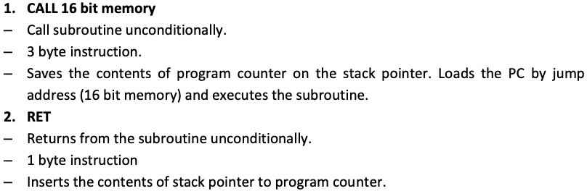
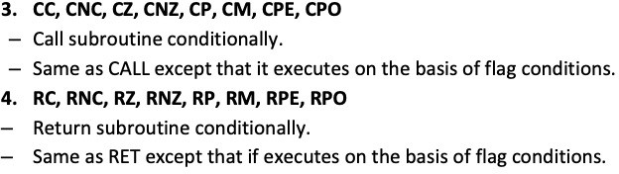
To implement subroutine there are two instructions CALL and RET.

Slide 87
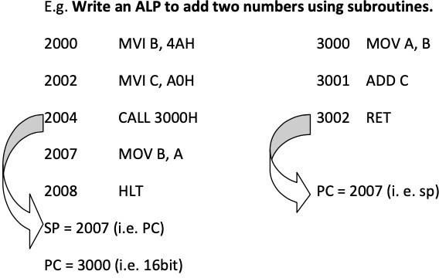

Slide 88
Restart Instruction:
8085 instruction set includes 8 restart instructions (RST).
These are 1 byte instructions and transfer the program execution to a specific location.
When RST instruction is executed, the 8085 stores the contents of PC on SP and transfers the program to the restart location.
Actually these restart instructions are inserted through additional hardware. These instructions are part of interrupt process.

Slide 89
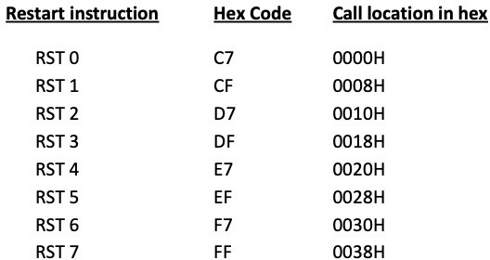

Slide 90
Miscellaneous Group Instructions:
STACK
The stack is defined as a set of memory location in R/W memory, specified by a programmer in a main memory.
These memory locations are used to store binary information temporarily during the execution of a program.
The beginning of the stack is defined in the program by using the instruction LXI SP, 16 bit address.
Once the stack location is defined, it loads 16 bit address in the stack pointer register. Storing of data bytes for this operation takes place at the memory location that is one less than the address

Slide 91
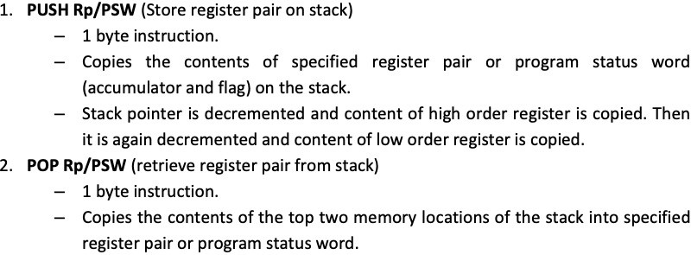
e.g. LXI SP, 2099H
Here the storing of data bytes begins at 2098H and continuous in reverse order i.e 2097H.
Therefore, the stack is initialized at the highest available memory location to prevent the program from being destroyed by the stack information.
The stack instructions are:

Slide 92
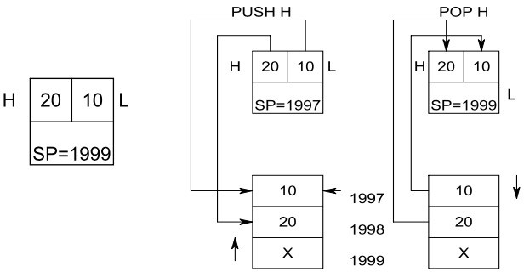
A content of memory location indicated by SP is copied into low order register and SP is incremented by 1.
Then the content of next memory location is copied into high order register and SP is incremented by 1.

Slide 93
XTHL =exchanges top of stack (TOS) with HL
SPHL =move HL to SP
PCHL =move HL to PC
Some instructions related to interrupt DI , disable interrupt EI = Enable interrupt
SIM = set interrupt mask
RIM = read interrupt mask

Slide 94
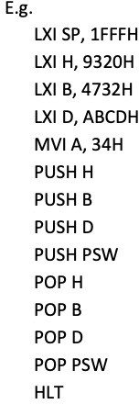
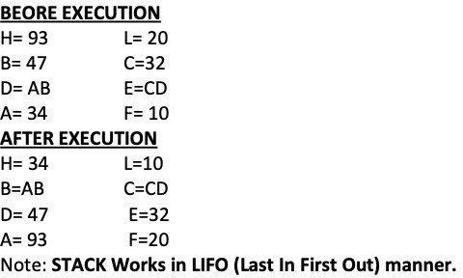

Slide 95
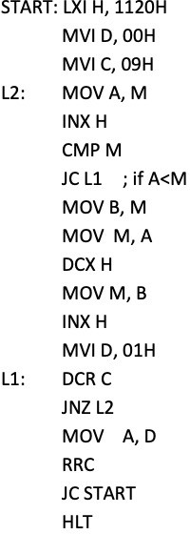
WAP to sort 10 bytes of data from 1120 H in ascending order.
If A < M, CY = 1.
Swept data if A > memory data
Checking the content of D, whether is it arrange on ascending order or not.

Slide 96
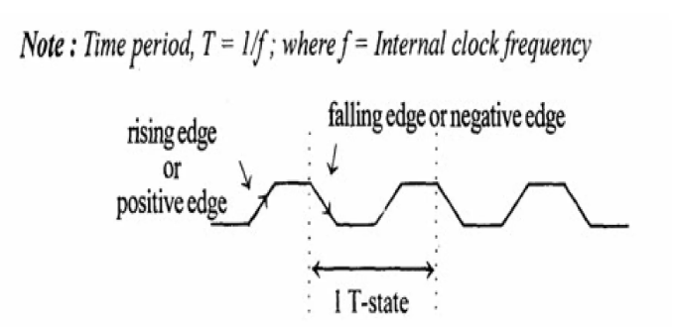
2.6 Timing Diagram
Timing Diagram is a graphical representation. It represents the execution time taken by each instruction in a graphical format. The execution time is represented in T-states.
Instruction Cycle: The time required to execute an instruction .
Machine Cycle: The time required to access the memory or input/output devices .
T-State: The machine cycle and instruction cycle takes multiple clock periods. A portion of an operation carried out in one system clock period is called as T-state.

Slide 97
2.7 RTL Instruction Descriptions
Register transfer language
• A specific notation used to specify the digital system is called register transfer language.
• For any function of the computer, the register transfer language can be used to describe the (sequence of) micro-operations
• Register transfer language
— A symbolic language
— A convenient tool for describing the internal organization of digital computers
— Can also be used to facilitate the design process of digital systems

Slide 98
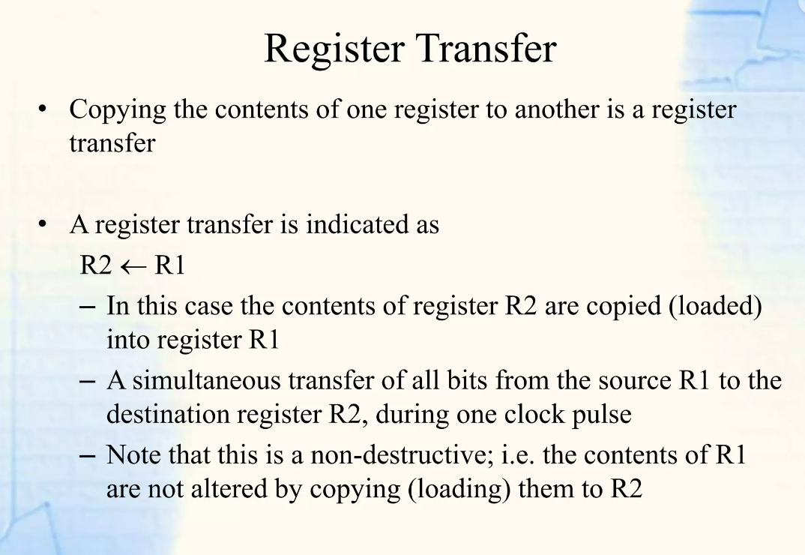

Slide 99
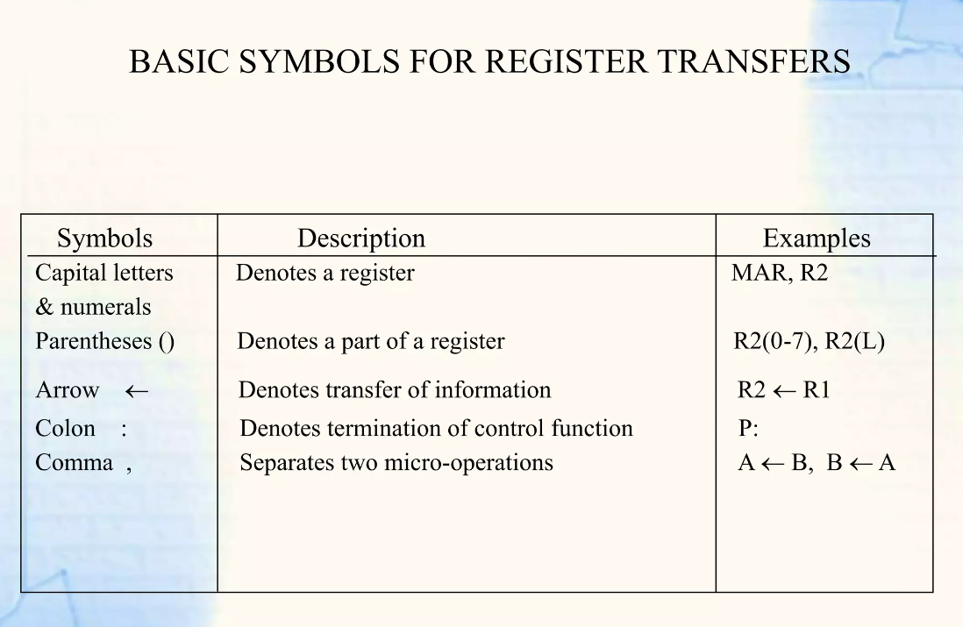

Slide 100
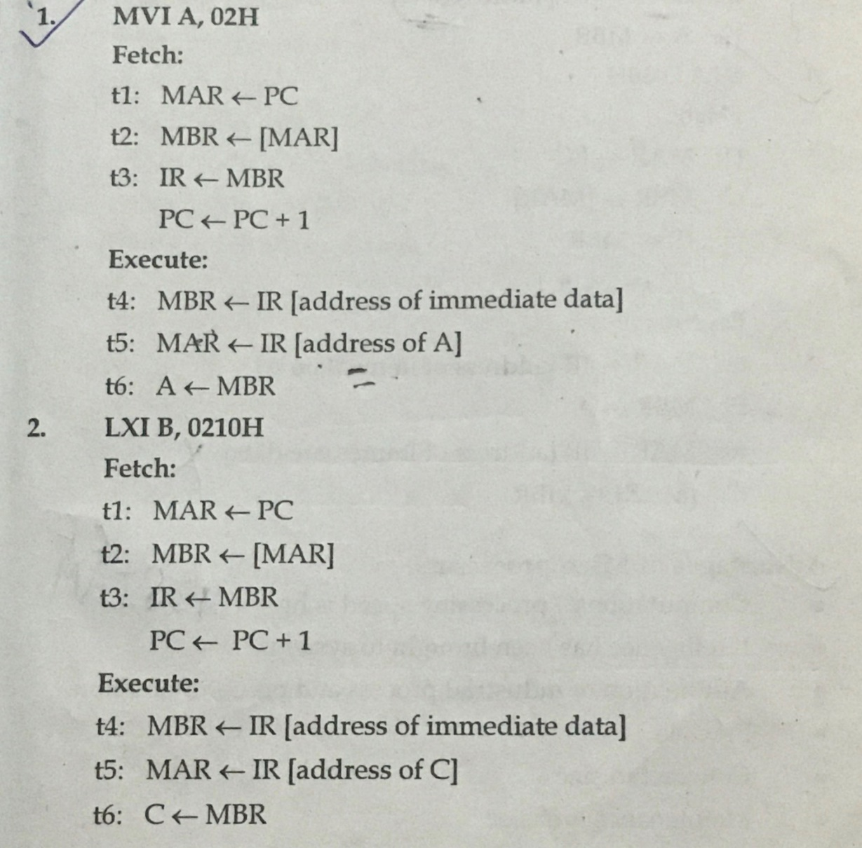
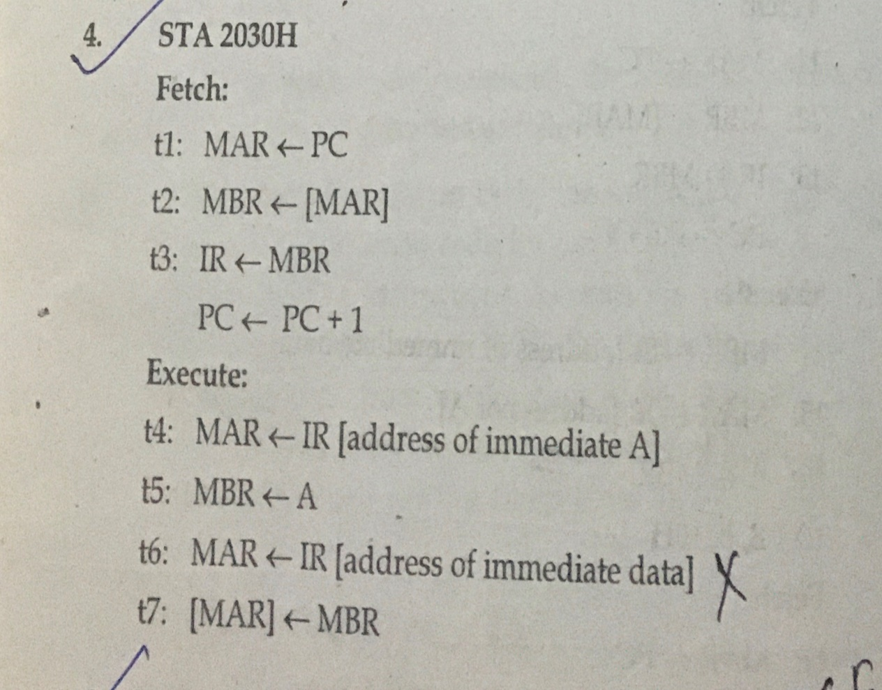
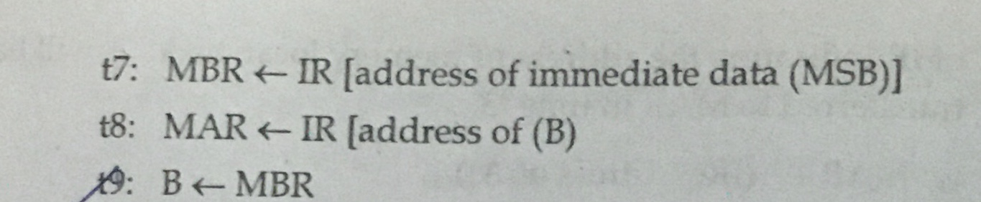

Slide 101
2.8 Assembly Language Program
Refer all programs done on classes.

Slide 102
End of chapter 02

